Slide 1
TOLLING
FOR THE
BOATS
DECEMBER

Slide 2
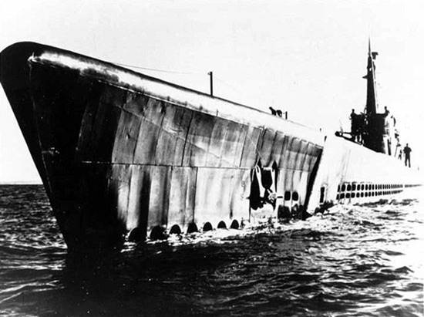
USS CAPELIN (SS-289)
Notes:
USS CAPELIN (SS-289) departed to finish her first war patrol on 17 November, 1943. Nothing was positively heard from CAPELIN after she departed. However, BONEFISH reported having seen a U.S. submarine in the area assigned to CAPELIN at the time. An attempt to reach CAPELIN by radio, on 9 December 1943, elicited no response. On 23 November an American submarine was attacked off Kaoe Bay, Halmahera, however, the Japanese state that this attack was broken off, and the evidence of contact was rather thin. Enemy minefields are now known to have been placed in various positions along the north coast of Celebes in CAPELIN's area, and she may have been lost due to a mine explosion. 76 Men Lost. (Bell & slide)

Slide 3
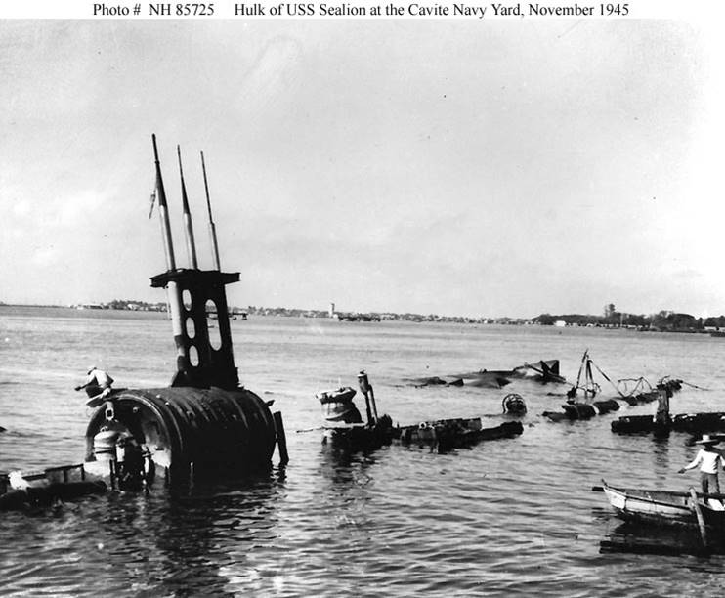
USS SEALION (SS-195)
Notes:
On Pearl Harbor Day, December 7, 1941, USS SEALION (SS-195) was at the Cavite Navy Yard, near Manila, undergoing an overhaul. Japanese aircraft raided that facility on 10 December, hitting the submarine with two bombs and killing four of her crewmembers. SEALION was very badly damaged and partially sunk. Since repairs could not be made under the desperate conditions then prevailing in the Philippines, she was stripped of useful equipment and, on 25 December 1941, deliberately wrecked with explosives. The first U.S. Navy submarine lost in World War II, her remains were broken up following the conflict's end. 5 Men Lost. (Bell & slide)

Slide 4
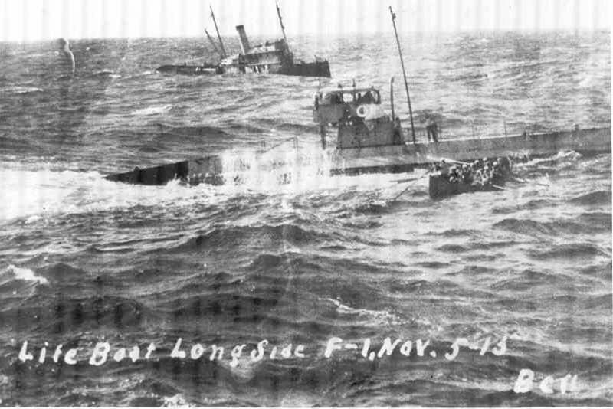
USS F-1 (SS-20)
Notes:
On 17 December, while maneuvering in exercises off Point Loma, San Diego, California, USS F-1 (SS-20) and F-3 collided, the former sinking in 10 seconds, her port side torn forward of the engine room. Nineteen of her men were lost, while three others were rescued by the submarine with whom she was operating. 19 Men Lost. (Bell & slide)

Slide 5
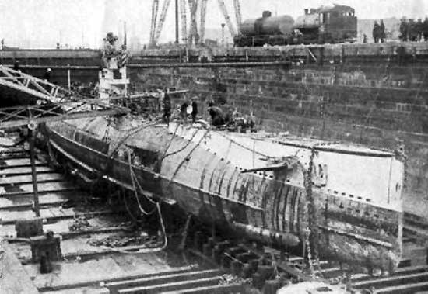
USS S-4 (SS-109)
Notes:
On 17 December 1927, while surfacing from a submerged run over the measured-mile off Cape Cod near Provincetown, Massachusetts, USS S-4 (SS-109) was accidentally rammed and sunk by the Coast Guard destroyer PAULDING. PAULDING stopped and lowered life boats, but found only a small amount of oil and air bubbles. Heroic efforts were made to rescue six known survivors trapped in the forward torpedo room, who had exchanged a series of signals with divers, by tapping on the hull. As the trapped men used the last of available oxygen in the sub, a diver placed his helmeted ear to the side of the vessel and received this morse-coded message, “Is … there … any … hope?” Sadly, there was no reason for hope and all six men perished. Despite best efforts all were lost. 40 Men Lost. (Bell & slide)

Slide 6
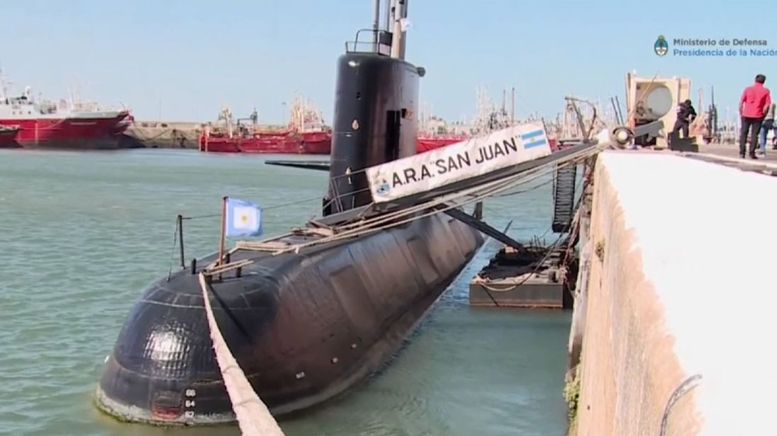
ARA San Juan
Notes:
Although we usually only remember boats of the U.S. Navy, this month we extend our thoughts and prayers to the 44 “Brothers (and Sister) of the Phin” and their families in Argentina. The ARA San Juan was returning from a routine mission to Ushuaia, near the southernmost tip of South America, when it reported an "electrical breakdown“ on November 15, 2017 and was not heard from again. More than a dozen countries have participated in the search for the sub that still remains lost at sea. 40 Shipmates Lost. (Bell & slide)

Slide 7
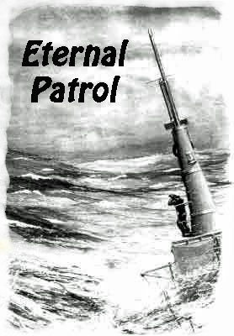
Notes:
And we should remember those sub sailors whose boats may have survived but who themselves departed on Eternal Patrol. Sailors, rest your oars. (Bell)

