Slide 1
TOLLING
FOR THE
BOATS
NOVEMBER

Slide 2
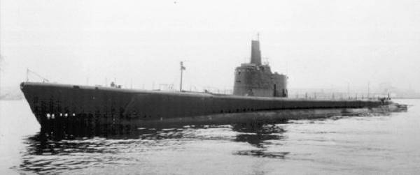
USS ALBACORE (SS-218)
Notes:
USS ALBACORE (SS-218) left Pearl Harbor on 24 October 1944, topped off with fuel at Midway on 28 October, and departed there for her eleventh patrol the same day, never to be heard from again. Enemy information available now indicates that ALBACORE perished by hitting a mine was witnessed by an enemy patrol craft. The craft reports having seen much heavy oil and bubbles, cork, bedding and various provisions after the explosion. Prior to her loss, ALBACORE had been a very successful submarine, especially in her engagements with Japanese combat vessels. Her record of enemy combatant ships sunk is the best of any United States submarine. She sank a total of 13 ships, totaling 74,100 tons, and damaged five, for 29,400 tons, during her first ten patrols. 85 men lost. (Bell & slide)

Slide 3
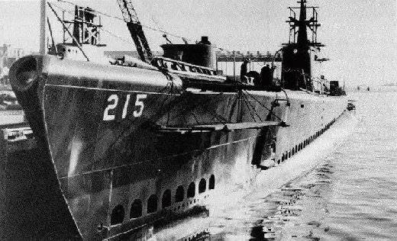
USS GROWLER (SS-215)
Notes:
USS GROWLER's (SS-215) 11th and final war patrol began out of Fremantle 20 October in a wolfpack with HAKE and HARDHEAD. On 8 November the wolfpack, headed by GROWLER, closed a convoy for attack, with GROWLER on the opposite side of the enemy from HAKE and HARDHEAD. The order to commence attacking was the last communication ever received from GROWLER. After the attack was underway, HAKE and HARDHEAD heard what sounded like a torpedo explosion and then a series of depth charges on GROWLER's side of the convoy, and then nothing. All efforts to contact GROWLER for the next 3 days proved futile, and the gallant submarine was listed as lost in action against the enemy, cause unknown. 86 men lost. (Bell & slide)

Slide 4
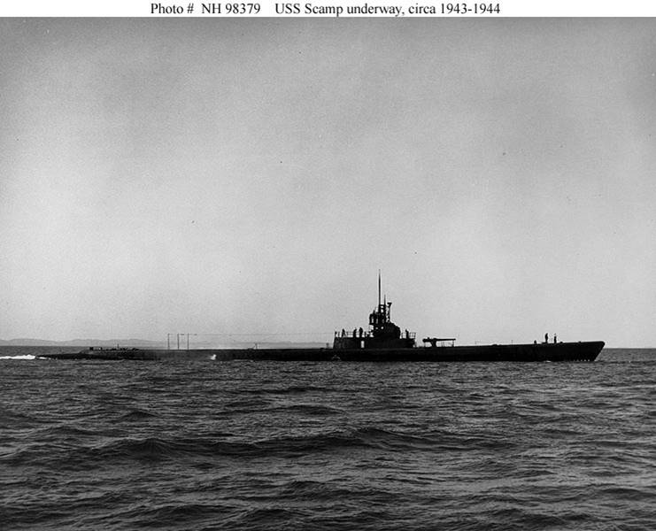
USS SCAMP (SS-277)
Notes:
USS SCAMP (SS-277) was ordered to the waters east of Japan for her eighth patrol, leaving Pearl Harbor in mid-October 1944, and was last heard from on 9 November. Postwar Japanese records indicate that SCAMP may have been sunk by air and escort ship attacks on 11 November, but it is also possible that she hit a mine. 83 men lost. (Bell & slide)

Slide 5
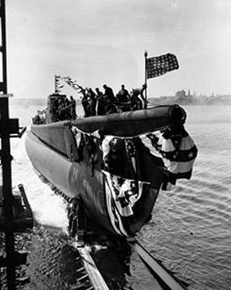
USS CORVINA (SS-226)
Notes:
On her first war patrol, USS CORVINA (SS-226) was directed by dispatch on 30 November to pass to command of Commander Task Force Seventy-Two on 2 December 1943. The message was repeated three times on each of two successive nights, and an acknowledgment was directed, but none was received. Since she had not appeared or been heard from since her departure from Johnston Island on 6 November, CORVINA was reported as presumed lost on 23 December 1943. Enemy records indicate that CORVINA met her doom on 16 November 1943, by enemy action. An enemy submarine reported having sighted a surfaced submarine in Latitude 5°-50'N, Longitude 151°-10'E, and torpedoed her. 82 men lost. (Bell & slide)

Slide 6
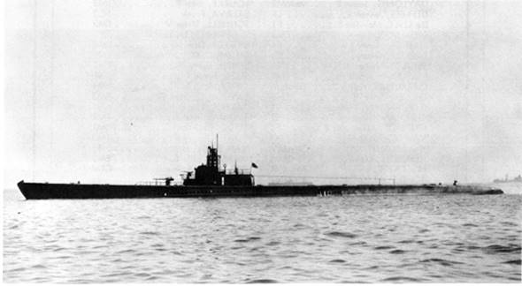
USS SCULPIN (SS-191)
Notes:
USS Sculpin (SS-191) left Pearl Harbor on her ninth patrol in early November. On 18-19 November 1943, SCULPIN attacked a Japanese convoy in the Central Pacific. In the ensuing action, she was damaged by depth charge attacks and forced to surface, then fought enemy escort ships in a gun battle that killed her commanding officer, Fred Connaway, and others of her crew. Fatally damaged, SCULPIN was deliberately submerged after most of the surviving crewmen had escaped. Captain Cromwell chose to ride her down to prevent possible compromise of secret information he possessed, an action for which he was awarded a posthumous Medal of Honor. A total of 63 Men lost, 51 of them as Prisoners of War. (Bell & slide)

Slide 7
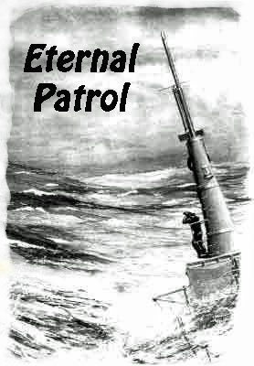
Notes:
And we should remember those sub sailors whose boats may have survived but who themselves departed on Eternal Patrol. Sailors, rest your oars. (Bell)

