Slide 1
Deadly Effective: US Subs vs Imperial Japanese Army Episode 501
Unauthorized History of the Pacific War Podcast
https://www.youtube.com/watch?v=QQFmxUw7aoo&t=47s

Slide 2
Unauthorized History of the Pacific War Podcast
Hosts:
Seth Paridon, Historian, MS Military Museum & Bill Toti, Captain, USN, Retired
Guest:
Richard B. Frank, Historian, Asian – Pacific War
Premise:
Did US Submarines Kill More Japanese Soldiers than the US Marine Corps in WWII?

Slide 3
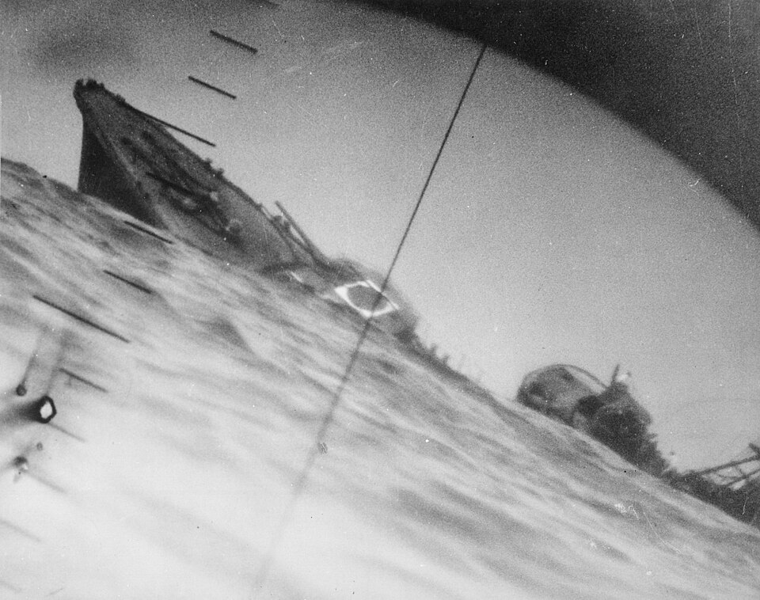
IJN Destroyer YAMAKAZE
Periscope Image Capture of the Sinking of IJN Destroyer Yamakaze by USS Nautilus, SS-142 in June 1942
Notes:
No Survivors

Slide 4
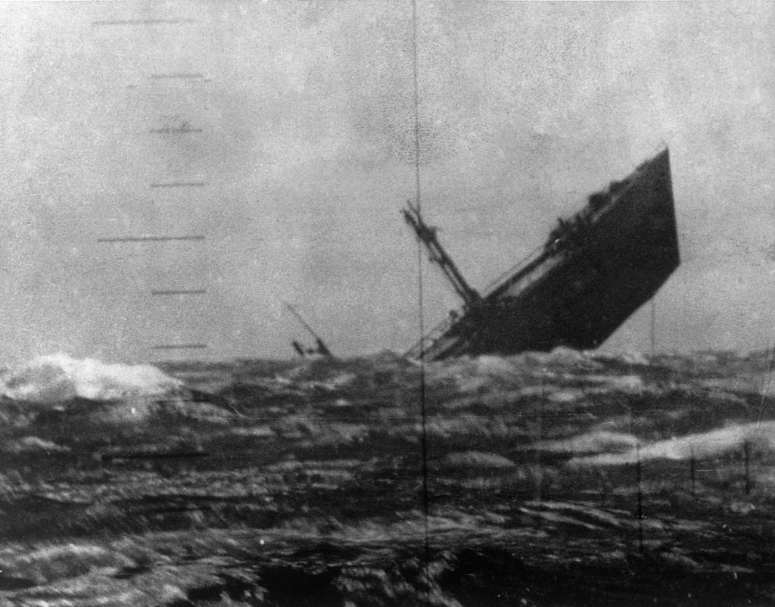
Japanese Merchant AZUCHISAN MARU
Periscope Image Capture of the Sinking of IJA Azuchisan Maru by USS Aspro, SS-309 in October 1944
Notes:
19 Crew, 3 Gunners, 83 IJA Soldiers

Slide 5
Joint Army Navy Analysis Committee 1947 (JANAC)
Review of All WWII Combat Successes Across All Services
Submarines Pacific:
Initial Response Phase 1941 - 1942 (S-Boats & Fleet Boats)
Coalescence Phase “Compromise Merchant Shipping” 1943
Maximum Effort Phase “The Great Killing Year” 1944
Final Phase “Slim Pickens!” 1945
Notes:
Every US Submarine had each Torpedo / Mine / Deck Gun Attack Assigned Serial Number
Combat War Patrols singularly or in Phases, Concurrent Special Operations Patrols Not Addressed Separately / Kept Classified & Unacknowledged

Slide 6
Initial Phase 1941 thru 1942 S-Boats & Fleet Boats
350 War Patrols
180 Japanese Merchant Ships Sunk <725,000 Tons>
Only One Major IJN Vessel Sunk, Heavy Cruiser Kako sunk by S-42, August 1942
USS Sturgeon sinks Montevideo Maru,
1,053 Australian POWs Killed
US Subs Kill 1,560 Japanese Soldiers
7 US Subs Lost from All Causes
USS Perch Lost - 03 March 1942
Notes:
Torpedo Problems | Skipper Problems | Tactics/Techniques/Procedural Problems |

Slide 7
Coalescence Phase 1943 Learning to Fight & Win
Uncle Charlie becomes COMSUBPAC RADM Charles Lockwood
Advances in Tactics, Techniques, & Procedures
Torpedo Firing Mechanism Failures Corrected
Torpedo Depth Running Failures Corrected
Torpedo Circular Running Failures Remain Uncorrected
Advances in Captains & Crews
Shared Knowledge:
<R&R @ Royal Hawaiian Hotel> JO & Enlisted
Only One Major IJN Vessel Sunk
Light Carrier Chuyo, by USS Sailfish SS-192
US Subs Kill 9,177 Japanese Soldiers aboard merchant and lesser IJN vessels
15 US Subs Lost from All Causes
USS Wahoo, Lost 11 October 1943
Japanese Merchant Shipping Impacted
Forces Alternative Routing of Imported Goods to Homeland
<Massive Ichigo Offensive in China>
Notes:
**Former USS Squalus **20 Captured Crew from USS Sculpin were onboard Chuyo at sinking, only one survived. IJN Chuyo was converted to light carrier from merchant ship Nitta Maru, 1940.

Slide 8
Maximum Effort Phase 1944 “The Great Killing Year”
1944 Commences with 100 Fleet Boats Available
IJA Response to US Island Hopping Campaign Successes - sent 12 Divisions of the IJA Elite Kwuntung Army in China to Pacific Island Bases via Merchant Shipping <Large Convoys – More Convoys – More Targets>
US Subs Reliable Torpedoes & Improved Sensors (SG RADAR), INTEL Intercepts
520 War Patrols, Sink 603 Merchant Ships, 2.7 Million Tons
Devasting Losses to Japanese Merchant Marine
135 of the Japanese Merchant Ships Lost Carrying 79,004 IJA Soldiers
Top 20 US Subs Killing Japanese Soldiers
2 Subs Responsible for Killing more than
half an IJA Division each
18 Subs Responsible for Killing more than
an IJA Regiment each
US Subs Sink 7 IJN Carriers, 1 Battleship,
2 Heavy & 7 Light Cruisers
19 US Subs Lost From All Causes

Slide 9
Maximum Effort Phase 1944 “Casualties of War”
11 Japanese Ships Sunk Carrying 11,597 Allied POWs & 4,328 Slave Laborers
USS Tang & USS Tullibee Lost from Own Torpedo Circular Runs
On 15th War Patrol, USS Seawolf sunk by Friendly Forces 04 October 1944, was carrying 17 USA Soldiers
USS Shark II, USS Darter, & USS Tang all lost in a single day, 24 October 1944
By end of 1944 UK Submarines begin operations in SW Pacific

Slide 10
Final Phase 1945 “Slim Pickens!”
158 Japanese Merchant Ships Lost Carrying 7,601 IJA Soldiers
8 US Subs Lost From All Causes
The last US Sub Lost in WWII
was USS Bullhead, SS-332,
Lost on 06 August 1945, 08:03 Hours, approximately twelve minutes before the detonation
of Atomic Bomb at Hiroshima.
Aerial Depth-Charge Attack near what is today’s Bali, Indonesia in the Java Sea.

Slide 11
JANAC ACCOUNTING 1947 “US Submarine Operations by Campaign”
Central Pacific Campaign =
(Gilbert Islands, Marshall
Islands, Marianas, Iwo Jima,
Eniwetok)
= 91,667 IJA Soldiers
Wake Island =
Philippines =
Guadalcanal =
Central Solomons =
Bougainville =
Okinawa =

Slide 12
Richard B. Frank (born November 11, 1947) is an American lawyer and military historian.
Born in Kansas, Frank graduated from the University of Missouri in 1969, after which he served four years during the United States Army. During the Vietnam War, he served a tour of duty as a platoon leader of the 101st Airborne Division. In 1976, he graduated from the Georgetown University Law Center.
Bibliography:
Frank has written several books and articles on the Pacific campaign of World War II and Southeast Asia:
Books:
• Guadalcanal: The Definitive Account of the Landmark Battle (1990)[2]—Won the General Wallace M. Greene
Award from the U.S. Marine Corps[3]
• Downfall: The End of the Imperial Japanese Empire (1999). ISBN 9780141001463.
• MacArthur (2007). ISBN 9781403976581.
• Frank, Richard B. (2020). Tower of Skulls: A History of the Asia-Pacific War, July 1937–May 1942 (First ed.). New
York: W. W. Norton & Company. ISBN 9781324002109.[4]
Articles:
• "No Bomb, No End", in What If? 2 (2001).
• "Why Truman Dropped the Bomb", The Weekly Standard (August 8, 2005): p. 20.
• "George Polk's Real-World War II Record", Washington Examiner (February 26, 2007)

