Slide 1
USS BLENNY
SS-324

Slide 2
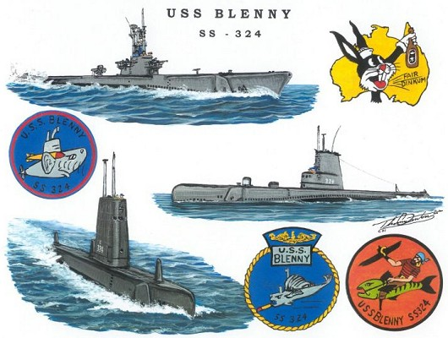

Slide 3
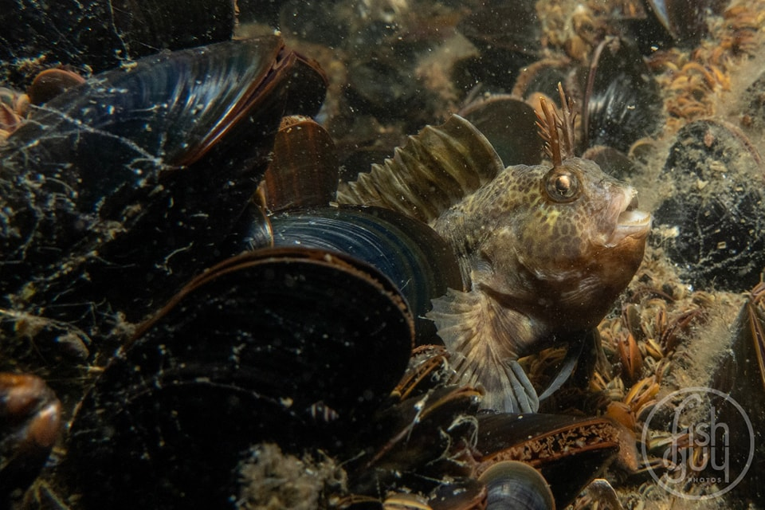

Slide 4
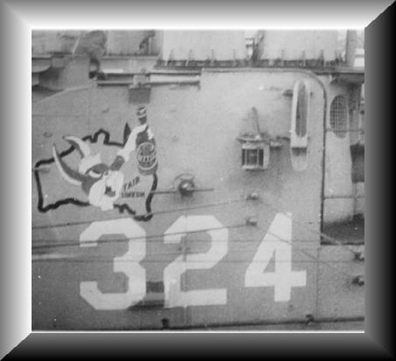

Slide 5
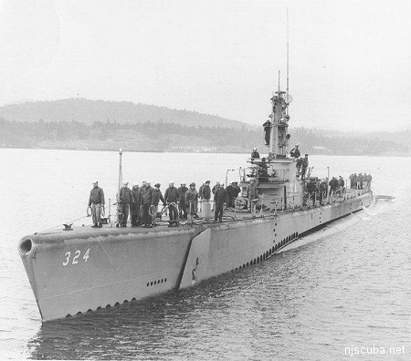

Slide 6


Slide 7
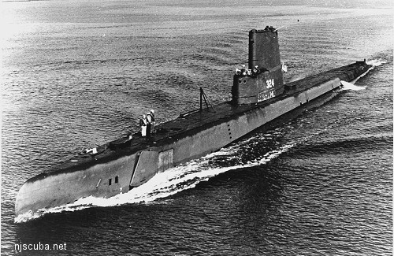

Slide 8
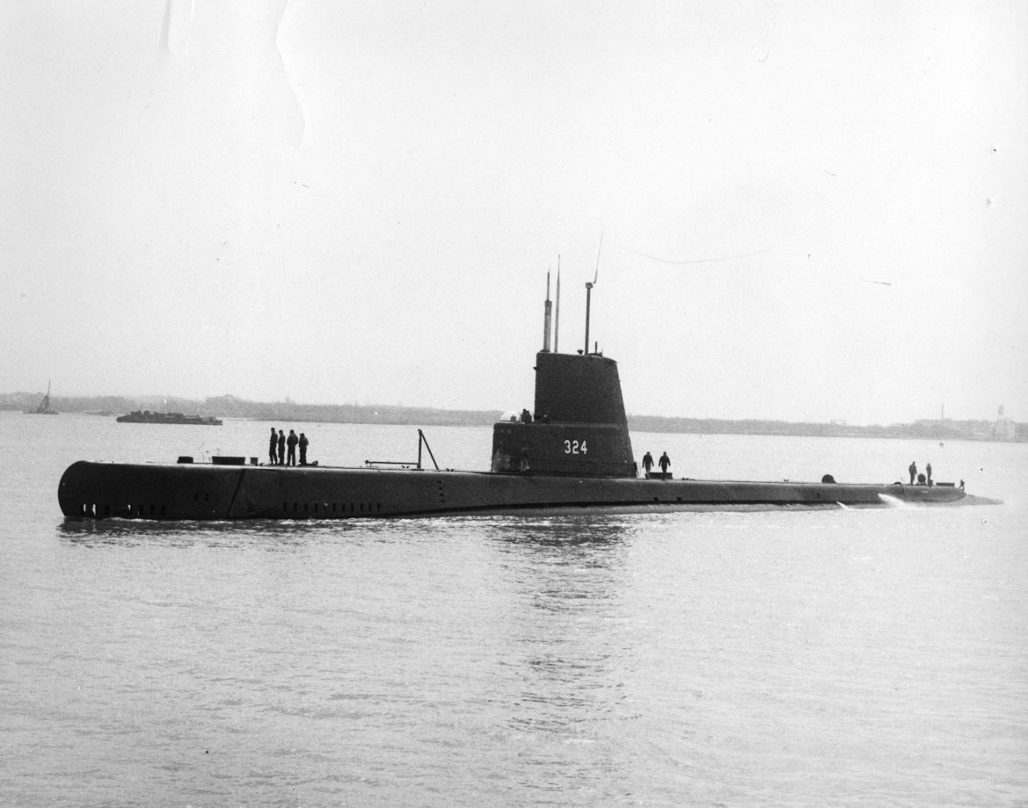

Slide 9
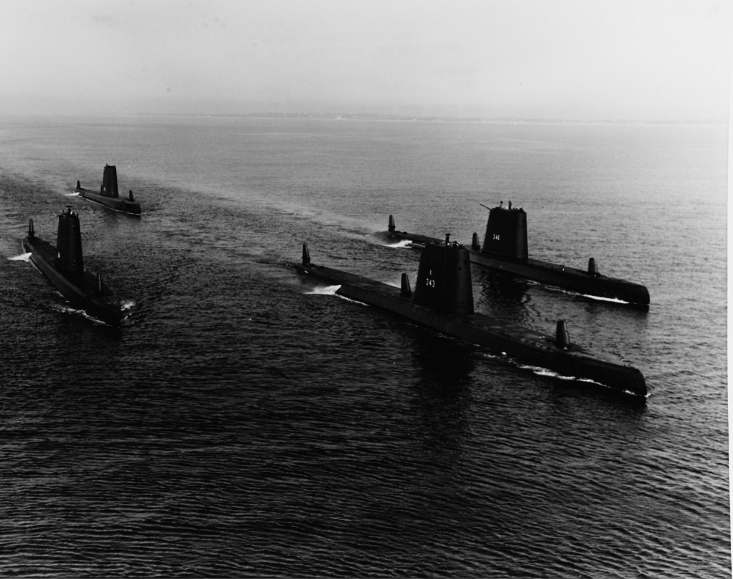

Slide 10
USS BLENNY (SS-324)
REFERENCES
New Jersey Scuba Diving
  https://njscuba.net/artificial-reefs/artificial-reefs-contents/uss-blenny/
YouTube References
  Paying it Forward USS COD & USS BLENNY
  https://www.youtube.com/watch?v=do3XKJEWAWs
Sinking the Kokoku Maru
  https://www.youtube.com/watch?v=wRe5vMkVXzw

Slide 11
USS BLENNY (SS-324)
REFERENCES (cont’d)
Frank’s Memory Page
http://www.submarinesailor.com/boats/324blenny/franktoon/f_memory.html
USS BLENNY NAV.MIL HISTORY
  PDF file on Perch Base website at https//perch-base.org/Events/2025/2025_09_13_Blenny/USS_BLENNY_NAV-MIL_HISTORY.pdf

